Slide 1
Financial Fraud:
What You Don’t Know Can Hurt You
August 13, 2014
Karen Baum, CPA, CFE
kbaum@crai.com

Slide 2
August 2014
UTA Alumni CPE
Financial Fraud Update
Regulatory Framework
  Evolution of Whistleblowing Laws
  What to Expect in 2014
Fraud Schemes 101
  Corruption
  Asset Misappropriation
  Financial Statement Fraud
Fraud Trends To Watch For In 2014
  Ponzi Schemes
  Cybercrime/Identity Theft
V. Going Forward

Slide 3

I. Financial Fraud Update
According to PwC’s 2014 Economic Crime Survey¹:
  One in every three companies reports being victimized by economic crime
  Crimes evolve and follow business megatrends
  Greatest risk are “systemic” crimes (bribery, corruption, antitrust and money laundering) compared to “episodic crimes” (asset misappropriation)
¹2014 Global Economic Crime Survey, PricewaterhouseCoopers

Slide 4
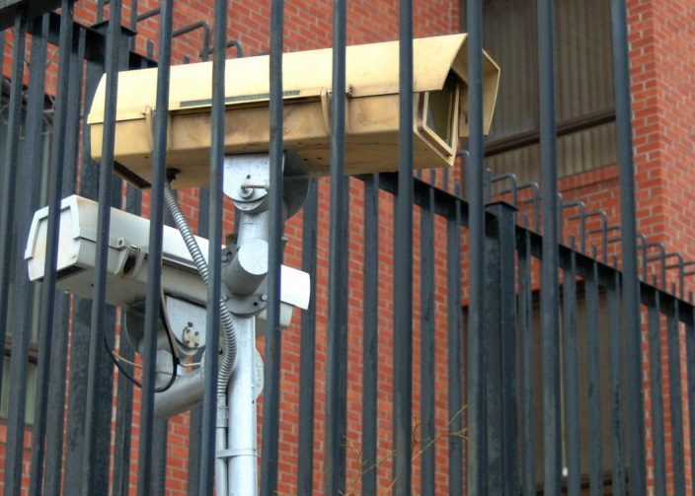
I. Financial Fraud Update
All businesses have exposure to economic crime
  Threatens basic processes of doing business
  Threats come from a variety of sources
The most damaging forms of economic crimes exploit the tension between 2 fundamental business goals
Profit
Compliance

Slide 5
I. Financial Fraud Update
Main Branches of the “Fraud Tree”²
Corruption
Asset
Misappropriation
Financial Statement Fraud
² According to the Association of Certified Fraud Examiners (“ACFE”) Occupational Fraud and Abuse Classification System referred to as the “Fraud Tree”.

Slide 6
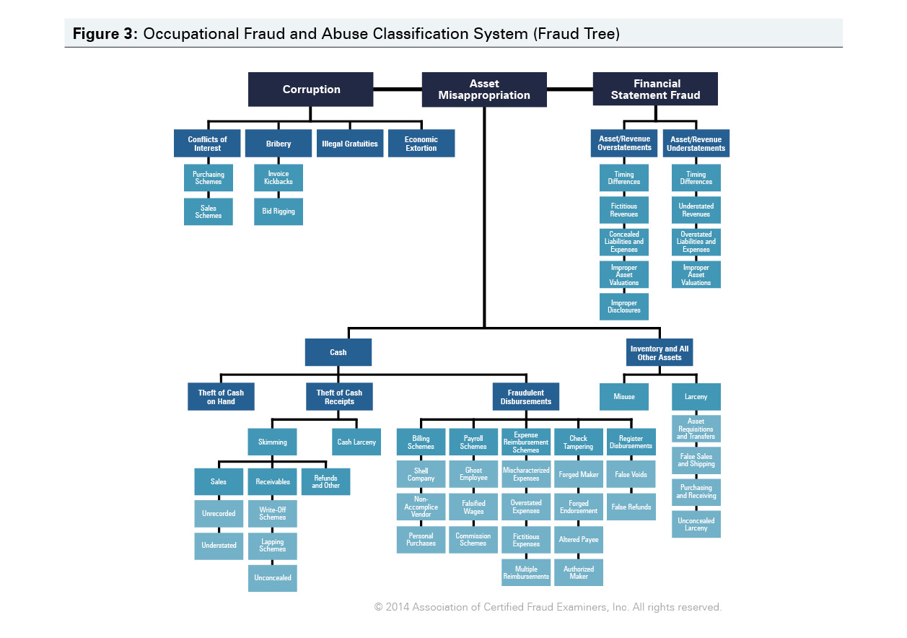

Slide 7
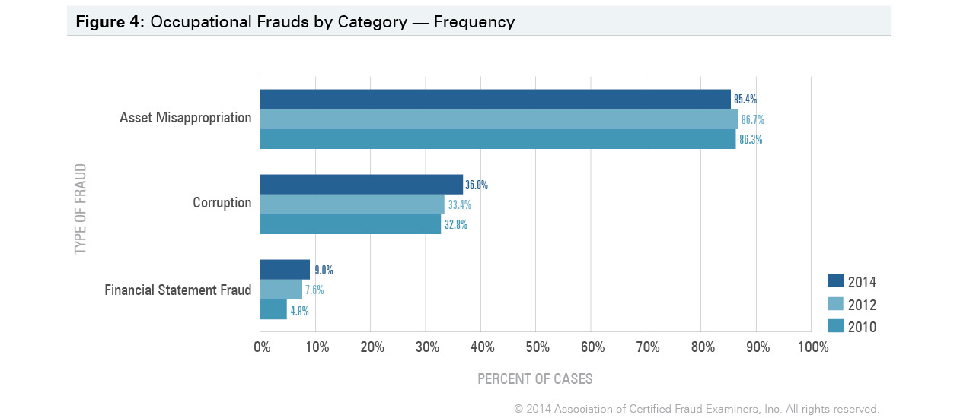
I. Financial Fraud Update
According to the ACFE 2014 Survey, Asset Misappropriations are most frequently observed
Source: ACFE Report to the Nations on Occupational Fraud and Abuse; 2014 Global Fraud Study

Slide 8
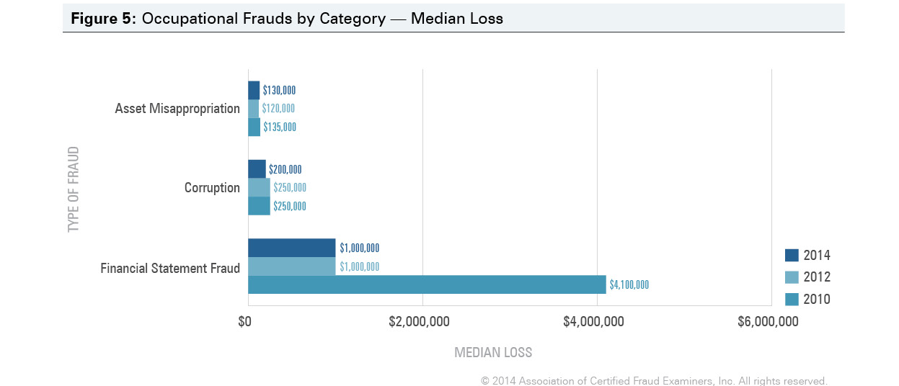
I. Financial Fraud Update
Asset Misappropriation accounts for the least median loss
Source: ACFE Report to the Nations on Occupational Fraud and Abuse; 2014 Global Fraud Study

Slide 9
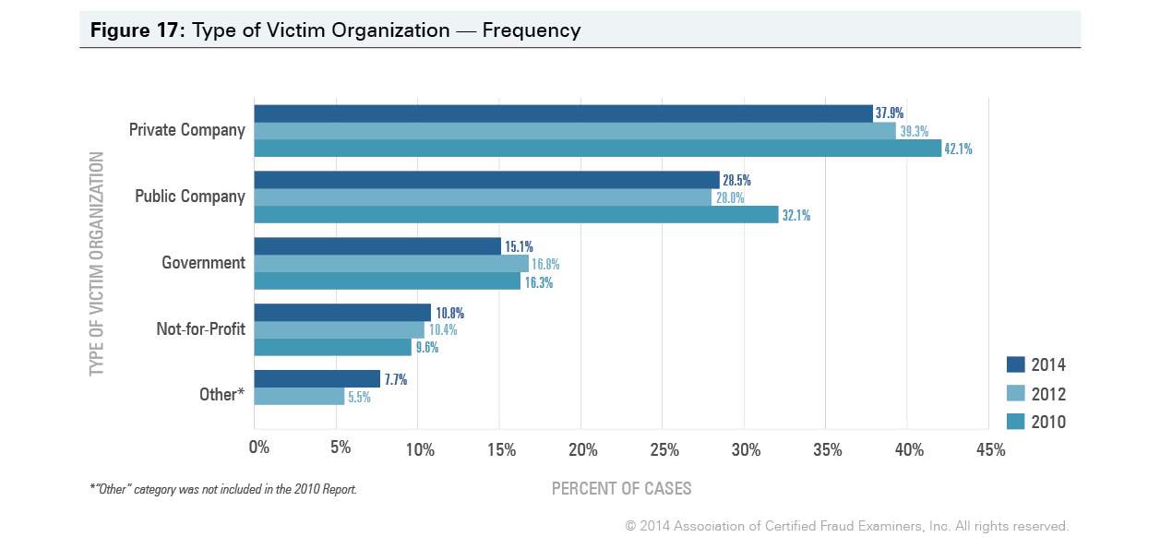
I. Financial Fraud Update
What type of organizations become the most frequent victims of fraud?
Source: ACFE Report to the Nations on Occupational Fraud and Abuse; 2014 Global Fraud Study

Slide 10
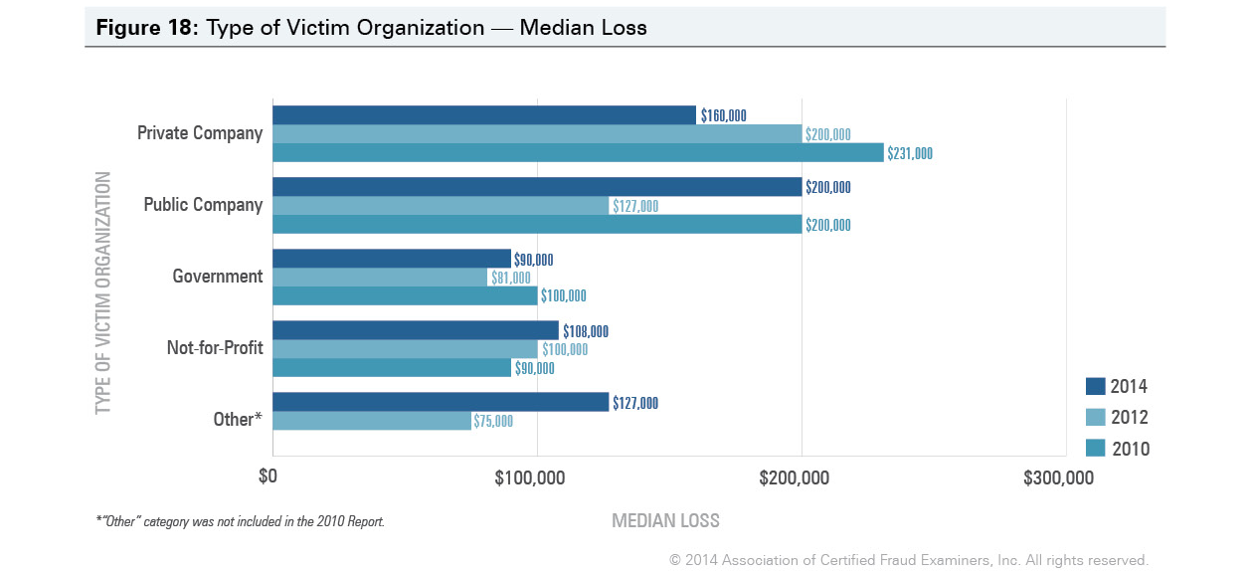
I. Financial Fraud Update
What type of organizations suffer the greatest losses?
Source: ACFE Report to the Nations on Occupational Fraud and Abuse; 2014 Global Fraud Study

Slide 11
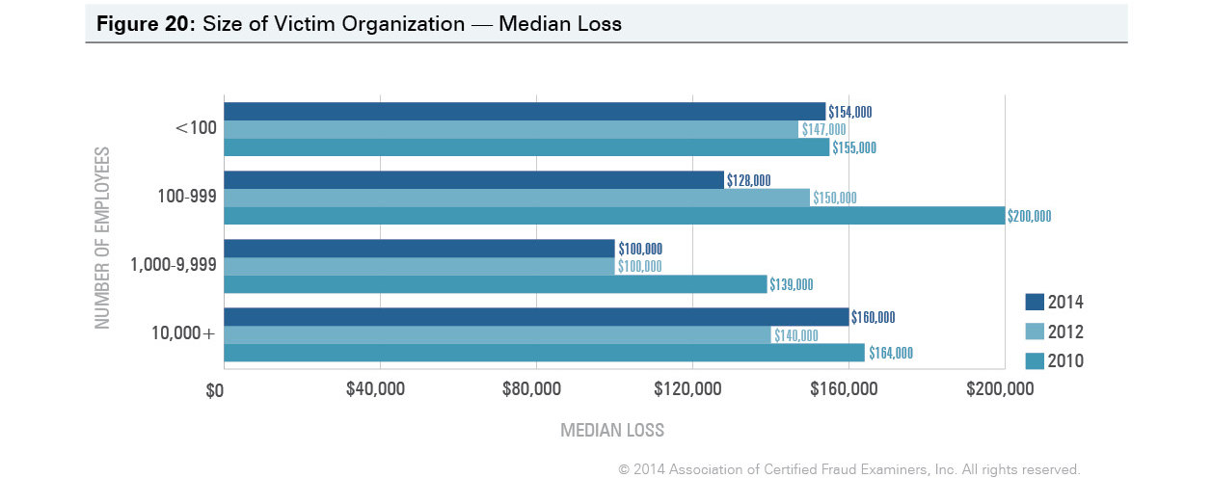
I. Financial Fraud Update
How does size of the organization affect the median loss?
Source: ACFE Report to the Nations on Occupational Fraud and Abuse; 2014 Global Fraud Study

Slide 12

I. Financial Fraud Update
Economic loss isn’t the only cost of fraud to a company
  Employee morale
  Disruption and distraction
  Negative publicity
  Reputational risk
  Business relationships
  Adverse relationships with regulators
  Share price
Q: With so many ways that fraud can be committed, what do you think the most effective method is for detecting fraud?

Slide 13

I. Financial Fraud Update
Tips are the primary method for initial detection of fraud
  Also referred to as “whistle blowers”
  Often made by disgruntled employees
  Tips account for more than 40% of all fraud cases detected
  Audit efforts render surprisingly low detection rates:
    External audits account for only 3% of frauds detected, while
    6% are found by accident
    6% are found by reconciling accounts

Slide 14
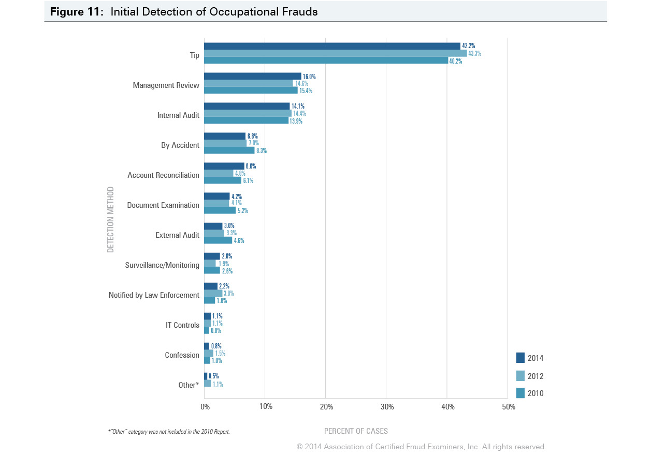
I. Financial Fraud Update
Source: ACFE Report to the Nations on Occupational Fraud and Abuse; 2014 Global Fraud Study

Slide 15
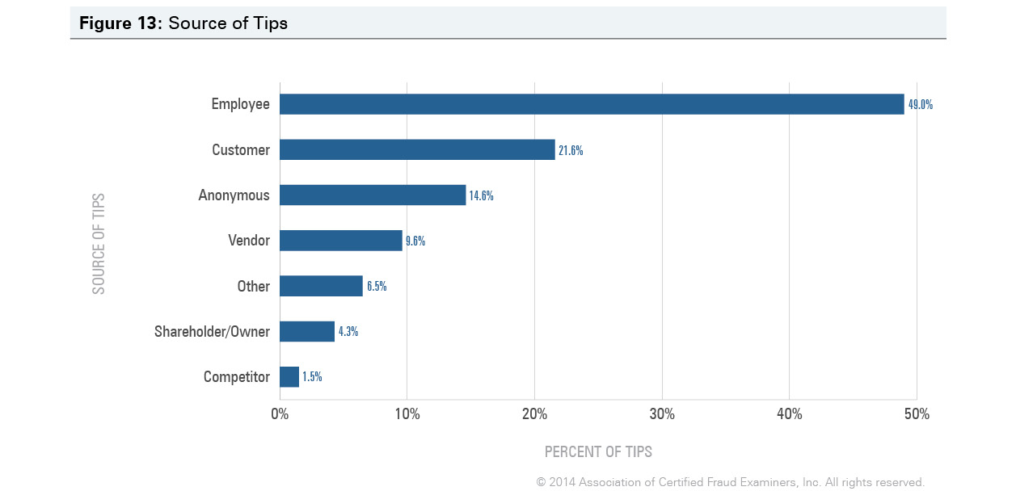
I. Financial Fraud Update
Who blows the whistle?
Source: ACFE Report to the Nations on Occupational Fraud and Abuse; 2014 Global Fraud Study

Slide 16

II. Regulatory Framework
Whistle Blower (“WB”) Laws
  A relatively recent area of law
  Evolved partly in response to major financial scandals and fraud
  Began in the late 1970s and covered corruption involving government employees
1978 - Civil Service Reform Act
  covered only government employees and proved ineffective
  No real protection for whistleblowers
    Burden of proof on whistle blower
Source: U.S. Securities and Exchange Commission, Office of Inspector General, Office of Audits, Assessment of the SEC‟s Bounty Program Inspector General Report), Rep. No. 474, at 5, Mar. 29, 2010.

Slide 17
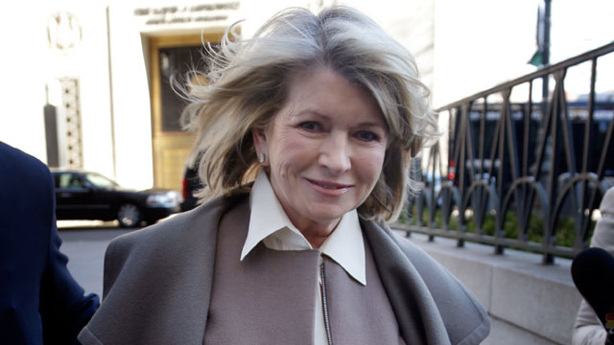
II. Regulatory Framework
1988 - Insider Trading and Securities Enforcement Act
  SEC WB bounty program for tips reporting insider trading
  Ineffective, made only 7 payments totaling $159,537 since inception
  Failed to prevent major insider trading violations that followed
Photo: Martha Stewart arrives at New York State Supreme Court in New York, March 5, 2013.
Seth Wenig/AP Photo
Source: U.S. Securities and Exchange Commission, Office of Inspector General, Office of Audits, Assessment of the SEC‟s Bounty Program Inspector General Report), Rep. No. 474, at 5, Mar. 29, 2010.

Slide 18
II. Regulatory Framework
1989 - Whistleblower Protection Act:
  Created a separate agency to litigate claims
  Permitted filing of WB claims without government support
  permitted courts to shift attorneys‘ fees from plaintiffs to defendants.
2002 - Sarbanes Oxley Act (SOX):
  Passed in response to corporate scandals at Enron and Worldcom
  SOX extended WB protection beyond federal employees to employees of publicly held companies
  required business controls to deter and detect fraud
  lowered the bar for statutory protection, only requiring the WB to have a “reasonable belief” of fraud

Slide 19
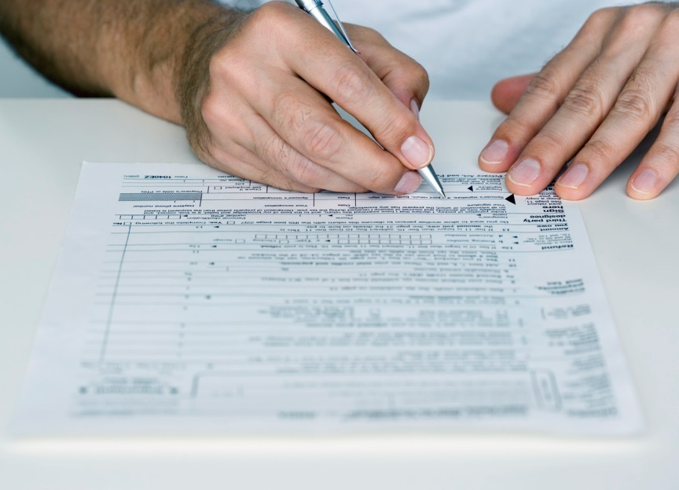
II. Regulatory Framework
2006 – IRS Whistleblower Law
  Enabled individuals to report:
    Underpayments of tax
    Other violations of IRS laws
  A WB can receive an award of
  between 15% to 30% of the collected
  proceeds (including penalties, interest, etc.)
  Has monetary thresholds before the law applies

Slide 20
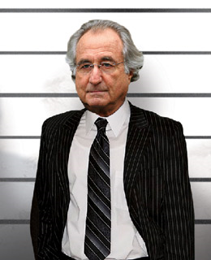
II. Regulatory Framework
2010 - Dodd-Frank WS Reform & CP Act
  Expanded WB protection and $$ incentives beyond SOX:
    10-30% bounty for all tips resulting in SEC or CFTC enforcement actions with monetary sanctions >$1M
    expands upon the SEC‘s existing insider trading bounty program.
Photo Illustration; Madoff: Andrea Renault / Polaris; Jupiter
    Provides protection to employees of all subsidiaries and affiliates of public companies and any individual performing tasks related to the offering or provision of a consumer financial product or service

Slide 21
II. Regulatory Framework
2011 - New SEC Whistle-Blower Rules
Significantly expand its prior program
  Revamped the SEC WB program, providing a direct mechanism for whistleblower complaints to the SEC
  Anyone can be a whistle-blower, including current and former employees, suppliers, customers and business partners
  The new rules apply to securities violations by:
    public companies
    private companies and those who work for public companies
Source: Texas Lawyer Business Journal; 12/19/11

Slide 22
II. Regulatory Framework
New Whistle-Blower Rules in 2011 (continued)
    private companies raising capital under federal securities laws exempt from registration
    broker-dealers
    investment advisors
  Offer significant protection to eligible reporters of wrongdoing
  Create substantial incentives to whistle-blowers and significantly increase exposures to corporations
Source: Texas Lawyer Business Journal; 12/19/11

Slide 23

II. Regulatory Framework
SEC’s 2013 WB Report to Congress
            Reported an 8% increase in tips and WB awards over the previous year
            The program made it’s largest single award to date of $14M* in 2013 from a tip regarding a fraudulent capital raise

Slide 24
II. Regulatory Framework
What to Expect in 2014
SEC will continue to make efforts to analyze tips carefully, particularly for financial reporting and accounting allegations, and use them to drive enforcement actions.
In this environment, companies should take appropriate steps to:
  Be Prepared
    Conduct risk assessments
    Establish policies and procedures that make it easy and safe for whistleblowers to submit internal complaints
    If you don’t whistle-blowers may go directly to regulators

Slide 25
II. Regulatory Framework
  Be Alert and Responsive
    Monitor internal complaints and react swiftly as they come in
    Get the right people involved
    Develop a game plan
  Be Disciplined
    Adhere to your investigative protocols
    Do not lose sight of issues related to business implications, privilege and potential self-reporting obligations
  Be Committed
    It is not enough to implement the framework of a system
    Companies must devote appropriate resources to compliance programs and obtain buy-in of key stakeholders

Slide 26
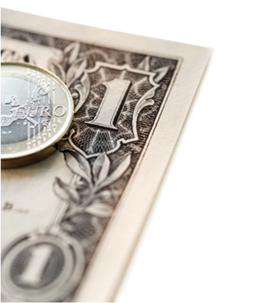
III. Fraud Schemes 101
  “The Big Three”
  Corruption
  Asset Misappropriation
  Fraudulent Financial Statements

Slide 27
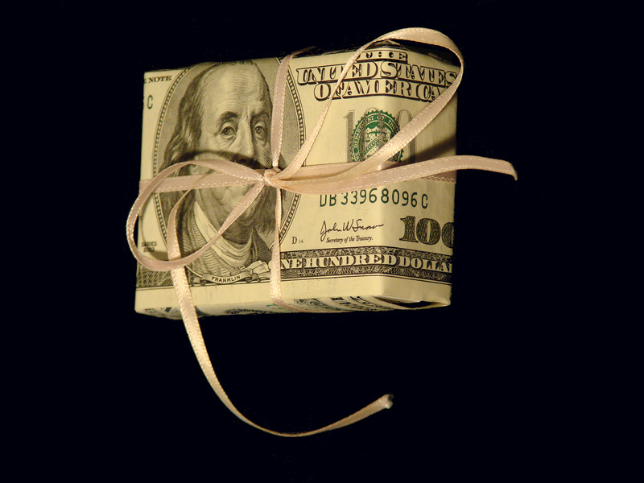
III. Fraud Schemes 101 – 1. Corruption
“Dishonest or fraudulent conduct by those in power, typically involving bribery.”
Starts/ends with “I had these friends.”
FUN FACTS:
One of the oldest white-collar crimes known to man
Hardest to detect
2014 Median loss $200,000

Slide 28
III. Fraud Schemes 101 - 1. Corruption
Common indicators:
Rising expenses for goods and services
Rapidly increasing purchases from one vendor
Excessive purchases of goods or services
Contracts written to limit competition (for example, sole-source contracts)
Purchasing becomes an advocate

Slide 29
III. Fraud Schemes 101 - 1. Corruption
% Bribery and Corruption Cases Reported by Industry 2014:
Source: Data from ACFE Report to the Nations on Occupational Fraud and Abuse; 2014 Global Fraud Study

Slide 30

III. Fraud Schemes 101 - 1. Corruption
Prevention and detection
Proactive analysis of quality and pricing issues
Extensive background investigations for vendors
Enforced right to audit clauses (conducted by “disinterested” parties)
Mechanisms to report waste and abuse
Code of conduct policies
Identify vendor’s fraud policy

Slide 31
III. Fraud Schemes 101 - 1. Corruption
Sample DOJ Settlements
Date | Company (HQ country) | DOJ Settlement Amount | Charge
4/1/2010 | Daimler AG (Germany) | $195 million | Made illegal payments to foreign officials worth tens of millions of dollars in at least 22 countries
2/11/2009 | KBR/Halliburton (U.S.) | $579 million | Led four-company global consortium that bribed Nigerian officials to win construction contracts
2/5/2010 | BAE Systems (U.S.) | $448 million | Paid $2 billion in bribes to Saudi Arabian ambassador Bandar bin Sultan in a multi-billion-dollar arms deal
Source: US Department of Justice

Slide 32
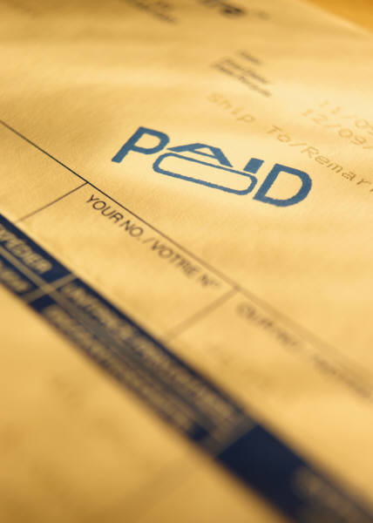
III. Fraud Schemes 101 – 2. Asset Misappropriation
  Billing Scandals
  The creation of a fictitious entity to receive payment for a fictitious purpose
  Purchasing personal items from legitimate vendors
  Often conducted through:
      Normal business process by a “sleepy” manager
      Forge approvals and all receiving documents
FUN FACTS:
Most common of all frauds
Easier to detect
2014 median loss $130,000

Slide 33
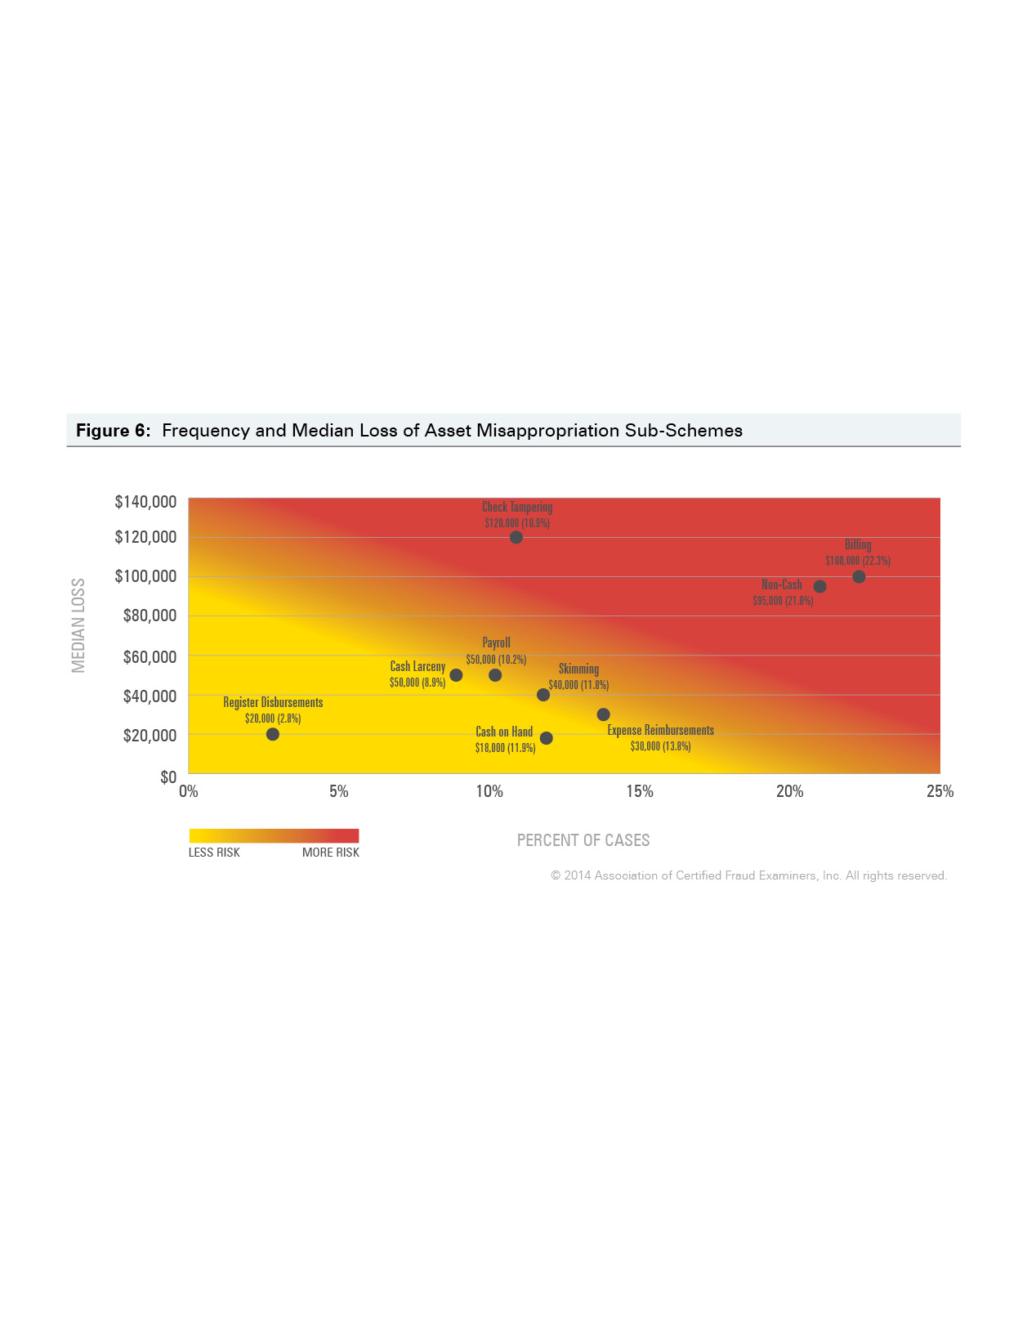
III. Fraud Schemes 101 – 2. Asset Misappropriation
Source: ACFE Report to the Nations on Occupational Fraud and Abuse; 2014 Global Fraud Study

Slide 34
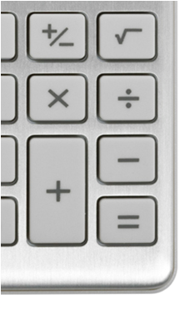
III. Fraud Schemes 101 – 2. Asset Misappropriation
Asset Misappropriation – Prevention and Detection
Analyze:
  Voided and/or missing checks
  Checks payable to employees
  Altered endorsements and/or payees
  Returned checks
  Duplicate checks
Controls to prevent theft:
  Rotate bank reconciliation
  Use bank assistance, such as positive pay
  Account confirmations
  Background checks!!

Slide 35

III. Fraud Schemes 101 – 2. Asset Misappropriation
Asset Misappropriation – Prevention and Detection
Other helpful controls:
  Use pre-numbered POs provided to vendors who include them on their invoice
  Extensive due diligence on new or unfamiliar vendors and their management
  Analyze expenditure variances by vendor and category

Slide 36

III. Fraud Schemes 101 – 3. Fraudulent Financial Statements
Most common schemes:
  Improper revenue recognition
  Concealed liabilities
  Capitalized expense
  Improper asset valuation
  Improper disclosures of:
    Significant events
    Related party transactions
FUN FACTS
FFS were only 9% of the total fraud cases reported
2014 Median loss reported $1 million (down from $4M in 2010)

Slide 37
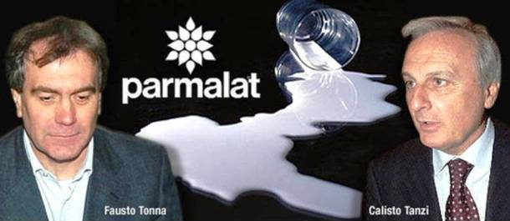
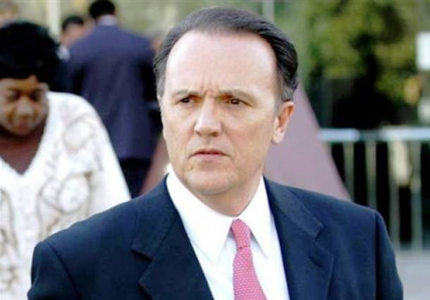
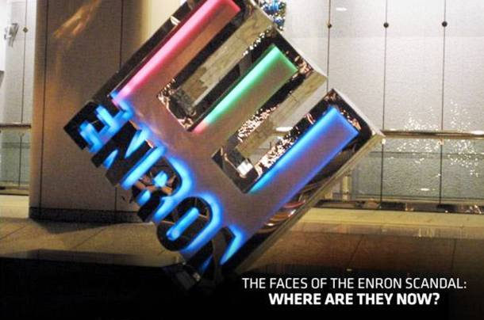
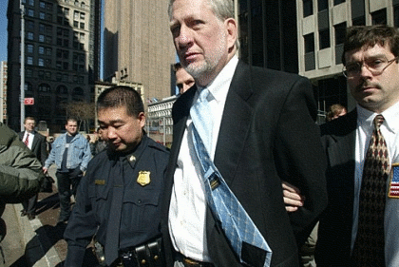
III. Fraud Schemes 101 – 3. Fraudulent Financial Statements
http://www.economist.com/node/2327955
2003 – Parmalat
€14B “hole” in the accounting records
http://list25.com/25-biggest-corporate-scandals-ever/
2003 – HealthSouth $1.4B embezzlement hidden by fake accounting entries
2001 – Enron
Hid billions in debt in offshore SPE’s
http://www.cnbc.com/id/45499018
2002 – Worldcom
$11B in overstated assets and $3.8B in fraudulent accounts
Photo ©2004 Allan Tannenbaum

Slide 38
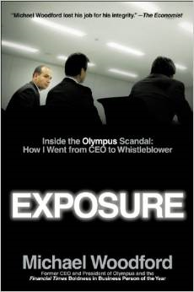
III. Fraud Schemes 101 – 3. Fraudulent Financial Statements
Olympus 13 year accounting fraud coverup
  In April 2014, litigation continues as 6 banks filed suit for damages
  Whistleblower Michael Woodford (former CEO) fired after blowing whistle on the $1.7 billion accounting fraud in 2011
  Olympus “Rotten From the Top”
  Not the mob but managers, who used accounting write-offs to cover up investment losses from the 1990s that would have blown a hole in Olympus’s balance-sheet.

Slide 39
III. Fraud Schemes 101 – 3. Fraudulent Financial Statements Prevention and Detection
DOCUMENTED fraud detection procedures such as:
  Journal entry review
  Detailed segregation of duties around crucial areas
  Extensive account reconciliation
  Significant analysis of variances
  Consistent enforcement of policies
  Adequate hiring and training
  Employee reporting mechanisms

Slide 40

IV. Fraud Trends To Watch For In 2014
  Old Schemes
    Ponzi Schemes
    Promises of security in an unsecure world
  New Schemes
    Cybercrime
    Replacement of people with systems changes the compliance game

Slide 41
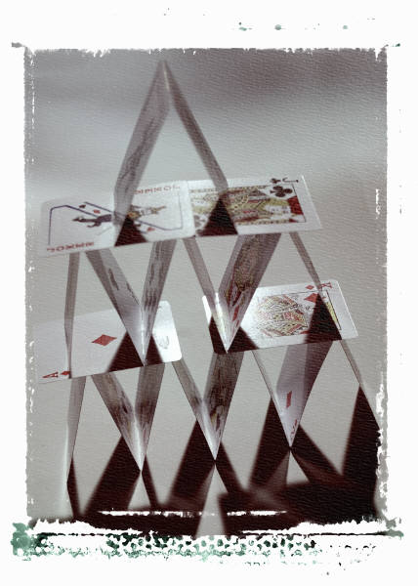
IV. Fraud Trends To Watch For In 2014
1. Ponzi schemes - Overview
  An investment fraud that involves the payment of $$$ purported returns to existing investors from funds contributed by new investors
  Lure new investors to invest in opportunities based on high returns with little or no risk
  Often involves real estate, luxury assets and business exchanges (in 1920, Ponzi sold discounted international reply coupons)
Source: www.sec.gov

Slide 42
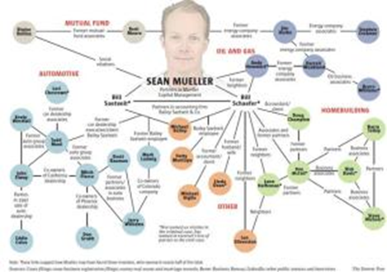
IV. Fraud Trends To Watch For In 2014
1. Ponzi schemes – Recent settlement in high profile Colorado case
Mueller’s accountants owned 5% of the fund and ran the scheme
Day trader who bilked investors out of $71 million
$10M settlement returns investors .16 on the $
Source: Denver Post, August 7, 2014

Slide 43

IV. Fraud Trends To Watch For In 2014
Ponzi schemes – Full Tilt Poker
Massive Ponzi scheme against its own players
  Lied to both players and the public about the safety and security of the money deposited
  Seven executives and others tied to Full Tilt were indicted as part of a federal crackdown after stealing +$100M
http://www.forbes.com/sites/docket/2010/06/01/will-online-poker-in-the-u-s-stop-today/

Slide 44
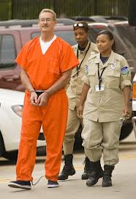
IV. Fraud Trends To Watch For In 2014
Ponzi schemes – Stanford update
  R. Allen Stanford indicted in 2009 for running a 20-year fraud that bilked investors out of $7 billion through:
    Funneling depositor’s dollars to a secret Swiss bank account used for personal purchases
    Bribes to regulators and auditors
    Employee bonuses
  10X the number of victims than Madoff – 28,000 people ripped off
  In prison serving a 110 year term
    Sources: CNBC, Scott Cohn, Saturday, 15 Feb 2014; KXKN 2/6/12; Washington Post 2/3/12; Houston Chronicle 9/15/09; photo: F. Carter Smith/Bloomberg News

Slide 45
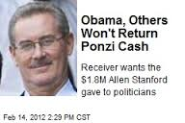
IV. Fraud Trends To Watch For In 2014
1. Ponzi schemes – Stanford update
    After 7 attorneys, he’s representing himself and is appealing his conviction
    Democratic and Republican recipients of $1.8M ponzi cash won’t return to investors
    Recovery was 1 cent on the dollar lost
    $2.5M Cooke Islands “Baby Mama Trust” set up for a mistress still in litigation
    Photo:http://www.newser.com/tag/38450/1/robert-allen-stanford.html

Slide 46
IV. Fraud Trends To Watch For In 2014
Ponzi schemes – Take away
Madoff/Stanford taught us to:
  compare the advisor’s market returns with those of actual markets (too high, too consistently?)
  conduct your own due diligence
  research through Financial Industry Regulatory Authority (www.finra.org) created in 2007, it receives 4,500 to 6,000 complaints per year
  make sure advisor abides with generally accepted industry practices (electronic almost real-time statements)

Slide 47
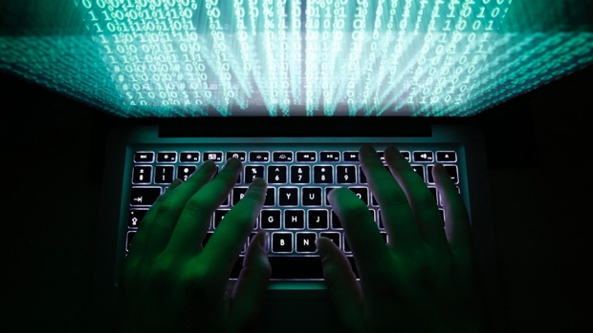
IV. Fraud Trends To Watch For In 2014
2. Cybercrime – what is it?
Defined as any criminal act dealing with computers and networks (called hacking) and includes traditional crimes conducted through the Internet;
  mass marketing frauds
  data breaches
  malware/viruses
  internet fraud
  identity theft
  credit card account thefts (when the illegal activities are committed through the use of a computer and the Internet)
Photo: CBC News

Slide 48
IV. Fraud Trends To Watch For In 2014
2. Cybercrime – dangerous combination of trends:
Cybercrime often occurs invisibly until the damage is done
45% of financial services organizations reported being victims of cybercrime - nearly 3X the frequency reported by all other industry sectors
Access & connectivity
Social media
Technology
Cybercrime
Source: 2014 Global Economic Crime Survey, PricewaterhouseCoopers

Slide 49
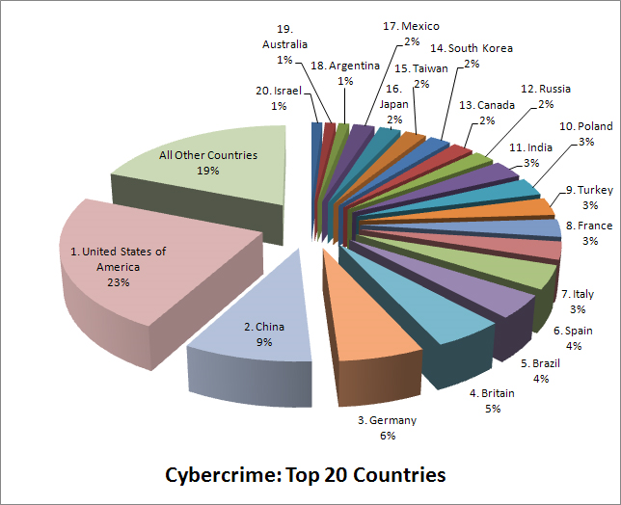
IV. Fraud Trends To Watch For In 2014
2. Cybercrime – where is it happening?
Source: BusinessWeek/Symantec

Slide 50
IV. Fraud Trends To Watch For In 2014
2. Cybercrime – Mass Marketing Fraud Types
According to the Internet Crime Complaint Center and FTC mass-marketing fraud schemes generally fall into three main categories:
Advance Fee
Bank and Financial Accounts
Investment Opportunities
Source: US Department of Justice

Slide 51

IV. Fraud Trends To Watch For In 2014
2. Cybercrime – Advance Fee Schemes
Victim is promised a million-dollar prize, lottery winnings, etc., but must pay in advance fees before receiving the benefit.
Auction and Retail Schemes
  Online auction websites are among the most frequently reported form of mass-marketing fraud.
  Offer high-value items - induce their victims to send money, but deliver nothing or an item far less valuable (e.g., counterfeit or altered goods).
Source: US Department of Justice

Slide 52
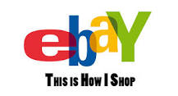
IV. Fraud Trends To Watch For In 2014
2. Cybercrime – Advance Fee Schemes
Auction and Retail Schemes
  In 2010, an eBay seller sentenced 68 months for operating a massive eBay auction fraud scheme.
  From 2003 to 2008, +5500 eBay transactions worth $717,000
  Used at least 260 different eBay accounts
  None of the items were ever shipped or delivered, and he simply kept the money for personal use.
Source: US Department of Justice

Slide 53
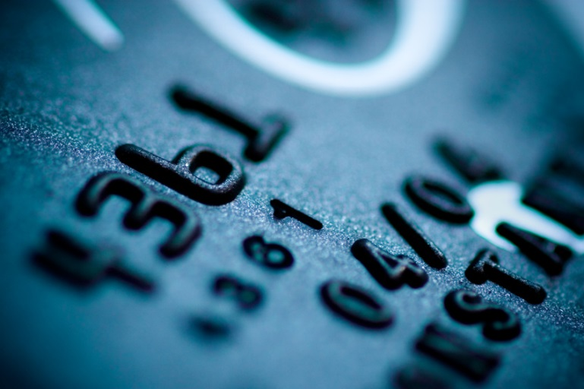
IV. Fraud Trends To Watch For In 2014
2. Cybercrime – Advance Fee Schemes
Business Opportunity/"Work-at-Home" Schemes
  Requires an up front fee, but fails to deliver materials that are needed to create a viable business
Credit-Card Interest Reduction Schemes
  Charge fees without actually
  reducing cardholders' interest rates
Source: US Department of Justice

Slide 54
IV. Fraud Trends To Watch For In 2014
2. Cybercrime – Advance Fee Schemes
Inheritance Schemes
  Contact prospective victims then make a series of demands for advance payment of various nonexistent fees before the inheritance can be transferred.
  Lottery/Prize/Sweepstakes Schemes
  Operate from a growing number of countries, such as Costa Rica, the Dominican Republic, Jamaica, the Netherlands, Nigeria etc., thru email they claim the victim has just won a substantial lottery prize or sweepstakes, but must pay a number of nonexistent "fees" or "taxes" before he or she can receive the prize.
Source: US Department of Justice

Slide 55
IV. Fraud Trends To Watch For In 2014
2. Cybercrime – Bank and Financial Account Schemes
Mass contacts with individuals to trick them into providing bank or financial account data, gain access steal funds or charge goods to the victims' cards.
Identity Theft - the wrongful obtaining and using of someone else's personal data involving fraud or deception, typically for economic gain.
Data Breach
Phishing
Vishing
Source: US Department of Justice

Slide 56

IV. Fraud Trends To Watch For In 2014
2. Cybercrime – Bank and Financial Account Schemes
Phishing – uses email
Vishing – is voice phishing
Q6
FUN FACTS:
Identity fraud complaints decreased
21% in 2013, but still is the FTC’s #1 complaint
Intuit has a great explanation of phishing, vishing, smishing and
pharming at:
https://security.intuit.com/phishing.html
Source: US Department of Justice

Slide 57
IV. Fraud Trends To Watch For In 2014
2. Cybercrime – Bank and Financial Account Schemes
Identity Theft / Fraud Statistics | Data
Average number of U.S. identity fraud victims annually | 11,571,900
Percent of U.S. households that reported some type of identity fraud | 7 %
Average financial loss per identity theft incident | $4,930
Total financial loss attributed to identity theft in 2013 | $24.7B
Total financial loss attributed to identity theft in 2012 | $21.0B
Total financial loss attributed to identity theft in 2010 | $13.2B
Percent of Reported Identity Thefts by Type of Fraud | Percent Reported
Misuse of Existing Credit Card | 64.1 %
Misuse of Other Existing Bank Account | 35.0 %
Misuse of Personal Information | 14.2 %
Source: US Department of Justice, Javelin Strategy & Research

Slide 58

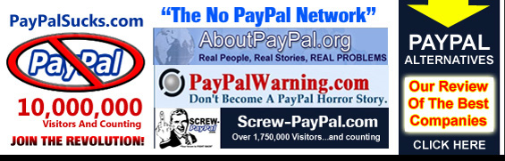
IV. Fraud Trends To Watch For In 2014
2. Cybercrime – Bank and Financial Account Schemes
How safe is Paypal?
  Do your own due diligence
  Be sure to check the FTC,
  and other consumer sites
Source: www.paypalsucks.com

Slide 59
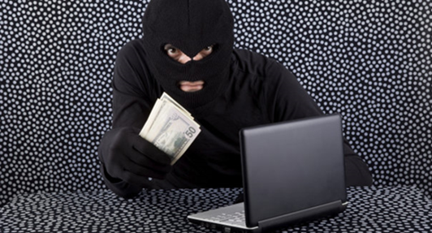
IV. Fraud Trends To Watch For In 2014
2. Cybercrime – Investing Schemes
“Pump-and-Dump" Schemes
Fraudulently drive price increases in thinly traded stocks
Immediately sell off their holdings of those stocks
Any other buyers of the stock who are unaware of the falsity of the information become victims of the scheme once the price falls.
Short-Selling ("Scalping") Schemes
Similar approach to pump and dump
Disseminating of false information to drive a stock price down
Source: US Department of Justice

Slide 60
IV. Fraud Trends To Watch For In 2014
2. Cybercrime – Other costs
Reputation –
  Target is still struggling to win back the trust of shoppers after hackers from Eastern Europe stole 40 million credit card numbers and 70 million addresses, phone numbers and other personal information last winter.
Personal safety and well being –
  People who have lost their life savings to fraud often become suicidal
  In certain cases foreign-based mass-marketing fraud schemes have resorted to kidnaping victims who have been persuaded to travel abroad, to ensure that they obtain as much money as possible from their victims and their families.
Source: US Department of Justice

Slide 61
V. Going Forward
As Investors ….
Scams generally have glaring red flags:
Can’t miss investments; guaranteed return (since when are there guarantees?)
Unsolicited materials – ignore investment-related “junk” faxes, emails, voice mail messages, and regular mail
Limited opportunities (limited because…..?)
Do your own due diligence:
Research potential investment opportunities - and who's behind them Compare promised rates of returns with that of industry
Are there right to audit clauses?
How is your investment protected?

Slide 62
V. Going Forward
As Leaders ….
Set the tone by creating new policies and be aggressive in enforcing them
Stay motivated and view the fact “you found something” as positive
Educate the workforce as to “lessons learned”
Wear “investor shoes” (what do they need to hear?)
Know the courts will give a reduced culpability score if the company:
  Voluntarily discloses wrongful acts in a timely manner
  Discloses information to appropriate authority
  Cooperates fully with the investigation
  Clearly accepts responsibility for its wrongdoing

Slide 63
V. Going Forward
As Individuals ….
Don’t judge a book by its cover (websites may not be legitimate)
Watch out for "Advance-Fee" demands
Avoid disclosing personal data over the phone or online
Beware of communications from parties that do not disclose their identity i.e., emails from “h1rX$d8y@provider.com”
Pay for online purchases by credit card or use an escrow service
Don’t respond to phishing, vishing or smishing requests for personal information
If you believe any of your accounts could be compromised, change your password immediately.
Lastly - What you don’t know can hurt you – so please protect yourself and stay informed!!!

Slide 64
YOUR TURN QUESTIONS?

